Slide 1

Department of Artificial Intelligence & Data Science
Statistical Machine Learning for Data Science (BAD702)
Mini Project Review
Project Title
HOTEL BOOKING CANCELLATION PREDICTION USING MACHINE LEARNING
Presented By:
K S KEERTHI ( 1EP23AD018 )
VINOD KUMAR A(1EP23AD060)
2026-2027

Slide 2
INTRODUCTION & PROBLEM STATEMENT
Hotel booking cancellations can cause revenue loss and inefficient resource management.
Traditional systems mainly record bookings but may not predict whether a customer will cancel.
Machine Learning can identify patterns in historical booking data.
The proposed system predicts whether a booking is likely to be:
  Cancelled
  Not Cancelled
  The system also provides a cancellation probability and risk level

Slide 3
ABSTRACT
The project develops a Hotel Booking Cancellation Prediction System.
Historical hotel booking data is used to train a machine learning classification model.
Important booking attributes are processed before prediction.
A Flask backend connects the trained model with the web application.
Users enter booking details through a simple frontend.
The system generates:
  Cancellation prediction
  Cancellation probability
  Risk level
A dashboard stores and displays previous predictions.

Slide 4
EXISTING SYSTEM AND PROPOSED SYSTEM
Existing System
Traditional hotel booking systems mainly focus on:
Booking registration
Customer information
Room availability
Reservation management
Cancellation recording
Proposed System
Our system uses Machine Learning to predict booking cancellation.
Features:
User-friendly web interface
Booking details as input
Automated data preprocessing
Machine learning prediction
Cancellation probability
Low / Medium / High risk classification
Dashboard for prediction history
Visualization using charts

Slide 5
HARDWARE AND SOFTWARE REQUIREMENTS
Hardware Requirements
Processor: Intel Core i3/i5 or equivalent
RAM: Minimum 4 GB
Storage: Minimum 5 GB free space
Display: Standard monitor
Input: Keyboard & Mouse
Software Requirements
OS: Windows / Linux
Language: Python
Frontend: HTML, CSS, JavaScript, Bootstrap
Backend: Flask
ML/Data: Scikit-learn, Pandas, Joblib
Visualization: Chart.js
IDE: VS Code
Browser: Chrome / Microsoft Edge

Slide 6
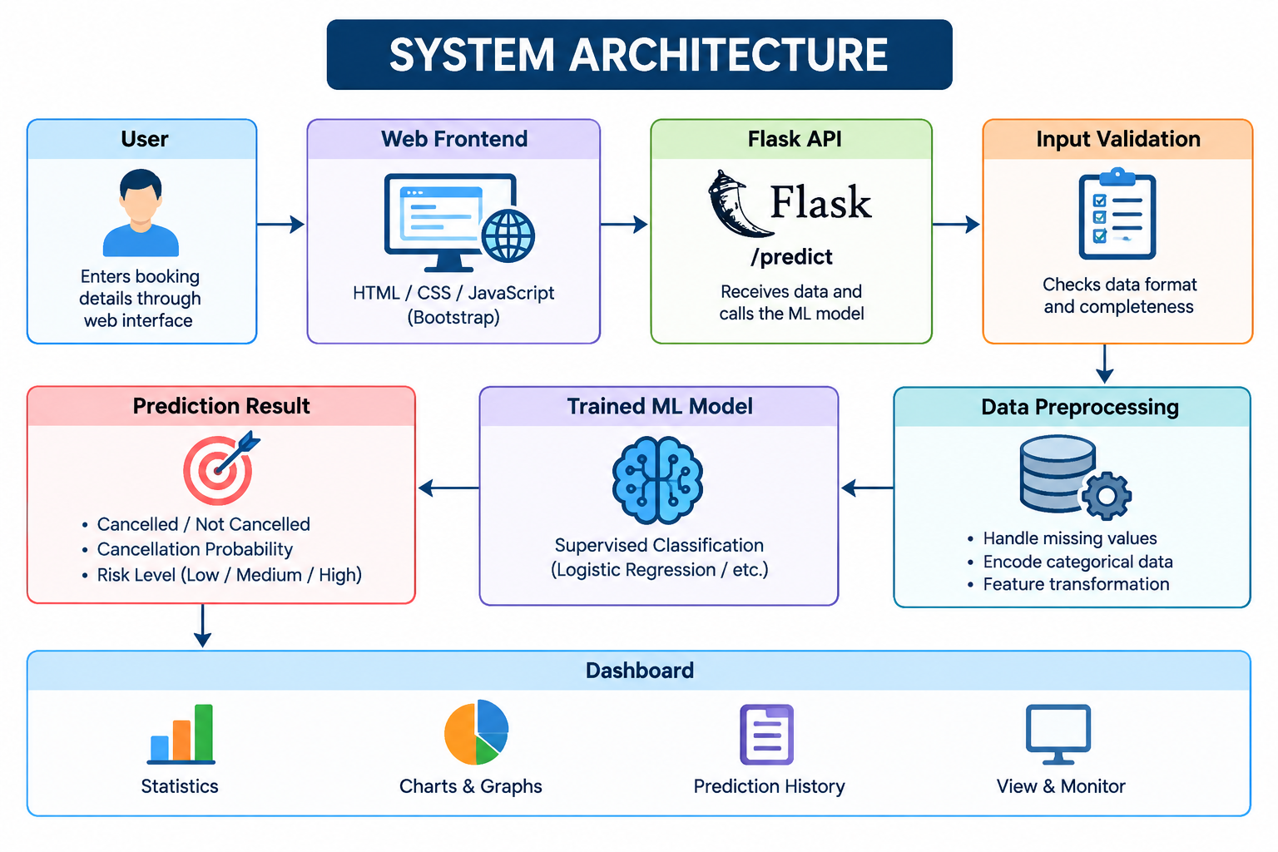
SYSTEM ARCHITECHTURE

Slide 7
ALGORITHM AND TECHNOLOGY
Algorithm
Supervised Machine Learning – Binary Classification
Collect hotel booking dataset
Clean and preprocess the data
Select relevant booking features
Encode categorical variables
Split data into training and testing sets
Train the classification model
Evaluate the model
Predict Cancelled / Not Cancelled
Calculate cancellation probability
Assign Low / Medium / High Risk
Technologies Used
Python – Machine Learning & backend
Pandas – Data processing
Scikit-learn – ML & preprocessing
Joblib – Model saving/loading
Flask – REST API backend
HTML, CSS, JavaScript – Frontend
Bootstrap – User interface
Chart.js – Dashboard visualization

Slide 8
IMPLEMENTATION
Data Collection: Hotel booking dataset is collected and analyzed.
Data Preprocessing: Missing values are handled and categorical data is converted into a suitable format.
Model Training: The processed data is used to train a supervised ML classification model.
Model Saving: Trained model and preprocessing pipeline are saved using Joblib.
Backend: Flask API receives booking details and performs prediction.
Frontend: HTML, CSS, JavaScript and Bootstrap provide a simple booking interface.
Prediction: System displays Cancelled / Not Cancelled, probability and risk level.
Dashboard: Prediction history and statistics are displayed using Chart.js.

Slide 9
REFERENCES & CONCLUSION
References
Kaggle – Hotel Booking Demand Dataset
Scikit-learn Documentation – Machine Learning and preprocessing
Pandas Documentation – Data analysis and data processing
Flask Documentation – Web application and REST API development
Bootstrap Documentation – Frontend interface design
Chart.js Documentation – Data visualization
Conclusion
Developed a Machine Learning-based Hotel Booking Cancellation Prediction System.
The system predicts whether a booking is Cancelled or Not Cancelled.
It provides cancellation probability and risk level.
Flask connects the trained ML model with the web interface.
The dashboard helps visualize and monitor prediction results.
The project demonstrates the practical application of Machine Learning in the hospitality domain.

